Slide 1
Fire Emergency Plan
Kidder Creek Camp

Slide 2
Outline
The Big Question
Cal Fire Consultation
Fire Simulation Modeling
Prevention and Safeguarding
Wildland Fire Emergency Plan for Kidder Creek Camp
Benefits to Community
Conclusion

Slide 3
The Big Question
When you have a fire will you be able to keep everyone safe?

Slide 4
Preparation of a robust plan
Have spent many hours in review of wildland fire fighting manuals and online resources
“The Red Book” (Interagency Fire Standards for Fire and Fire Aviation Operations)
The “Incident Response Pocket Guide” (IRPG) National Fire Coordinating Group (NWCG)
These documents were useful in leading us to a robust plan.
These documents are intended specifically for wildland firefighters going into a dangerous situation and so not all information contained therein pertains to our evacuation plan. **See appendix 1, 2**

Slide 5
Preparation of robust plan
Cal Fire Consultation
We have had numerous consultations with Cal Fire staff, including an on-site tour and review of our fire emergency plans. Through their review and on-site consultation they agree that:
We meet the requirements of PRC 4290 - outlined and defined through the EIR process.
Our wildland fire emergency plan is a good workable plan for evacuation.
Our safety zone for hunkering down is of ample size, if needed.
**We are in Cal Fire State Responsibility Area (SRA) in the Wildland Urban Interface (WUI)

Slide 6
Fire Simulations
Multiple different simulation models were run.
Normal Conditions
Catastrophic Conditions
Multiple and typical start points
**Simulations were run using Cal Fire Wildfire Analyst Simulations

Slide 7
Fire Simulations
“Normal Conditions based on conditions the same as the day the Shackleford Fire Started which started on 7/30/2022 and contained on 8/5/2022, it grew to 31 acres.
Start Location - Mid-slope, afternoon lighting strike with normal weather patterns for a day in August.
The edge of the wilderness
These simulations were run using a 24 hour period. Within that time the fire would be more than 3-4 miles from camp.

Slide 8
Fire Simulations
“Normal Conditions with Westerly Winds of 3-8 m.p.h.”
Start Location - Mid-slope, afternoon lighting strike with normal weather patterns for a day in August.
This simulation was run using a 8 hour period. Within that time the fire would still be 3-4 miles from camp.

Slide 9
Fire Simulations
“Catastrophic Conditions Simulation 1”
20 m.p.h. constant winds blowing toward camp depending on fire start location.
1 p.m. start on the South Side of Kidder Creek Drainage at the edge of the wilderness.
Under these conditions the simulation shows that it would likely take between 4 and 8 hours for the fire to reach the “safety zone” area.
**This model shows the direction of a fire coming from the Wooley Creek drainage.

Slide 10
Fire Simulations
“Catastrophic Conditions Simulation 2”
20 m.p.h. constant winds blowing toward camp depending on fire start location.
1 p.m. start on the North Side of Kidder Creek Drainage at the edge of the wilderness.
Under these conditions the simulation shows that it would likely take between 4 and 8 hours for the fire to reach the “safety zone” area.

Slide 11
Fire Simulations
“Catastrophic Conditions Simulation 3”
20 m.p.h. constant winds blowing toward camp depending on fire start location.
1 p.m. start in the residential area off of Valley Pines Dr.
Under these conditions the simulation shows that it likely would take over 8 hours for the fire to reach the “safety zone” area.

Slide 12
Fire Simulations
“Catastrophic Conditions Simulation 4”
20 m.p.h. constant winds blowing toward camp depending on fire start location.
1 p.m. start in the residential area in Greenview.
Under these conditions the simulation shows that it would likely take as little as 2-4 hours for the fire to reach the “safety zone” area.

Slide 13
Fire Simulations
All simulations were done without suppression tactics which, when implemented, gives us more time!

Slide 14
Fire Simulations Conclusion
Under “Normal” Conditions there is ample time for evacuation with hours to spare.
Under “Catastrophic” Conditions in all but the very worst scenario we have ample time for a 2 hour evacuation.
**The chance of these catastrophic conditions existing are very low.
**When suppression tactics and interventions are implemented, this adds to the time available for evacuation.

Slide 15
Prevention and Safeguarding
Management by staff of ongoing fuel reduction work, specifically along roadways, program areas and around the “safety zone”.
In collaboration with Neighbors for fuel reduction and fire break projects.
Working with Forester Dan Larivee, through the California Forest Improvement Program (CFIP) on fuel reduction projects. Have completed our Forest Management Plan and have applications for funding for key projects as designated through our plan.
We manage “Defensible Space” around all buildings and in program areas and receive yearly inspections by the local fire chief.

Slide 16
Emergency Plan
LCES is an acronym used by firefighters when they go in to an area to fight fire. This acronym is the standard used to keep firefighters safe and it includes 4 key components.
Lookout
Communication
Escape Route – which we will call Evacuation
Safety Zone

Slide 17
Lookout
There are multiple managed lookout sites watching for fire starts in our area. Duzel Rock managed by Cal Fire being the main lookout which has a clear view right up the Kidder Creek drainage.
All Kidder Creek Camp Staff are trained in child safety and keeping “The Big Eye” the big eye means that staff are constantly on the lookout for anything that would be unsafe to the campers, including fire.

Slide 18
Communication
Use of apps for information about lightning strikes and fires.
County Alert Systems.
Cell phone use to communicate with outside resources as well as with on site staff.
Alarm system at camp to alert staff and campers of a emergency situation.
If there is a evacuation notice, we immediately implement our evacuation procedures.

Slide 19
Evacuation
Our primary evacuation route is down South Kidder Creek Road.
If the primary option is compromised, the Secondary evacuation route will be used out Taylor Divide, connecting to Patterson Creek Road.
(This secondary route will be completed before approval of the permit.)
**See Fire Evacuation Plan map – appendix 3.

Slide 20
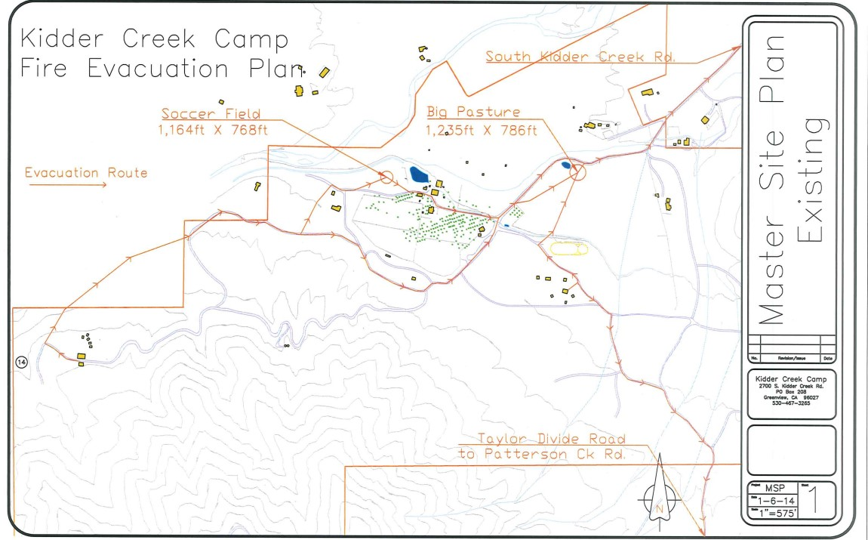

Slide 21
Evacuation
Immediate Actions
Alarm will be used for “Emergency” Fire Evacuation
Church is called immediately
Support Staff go immediately to the office to get vehicle and driving assignments.

Slide 22
Current Evacuation
All Campers are evacuated within 2 hours.
Within 30 minutes
All Campers Assemble in program area, head count and walk to “Temporary Refuge Area”.
Programs with vehicles depart immediately. Campers and counselors stay at church, program leads drive back to camp to pick up another load of campers.
Outdoor Day Camp is evacuated and to home immediately by onsite transportation.

Slide 23
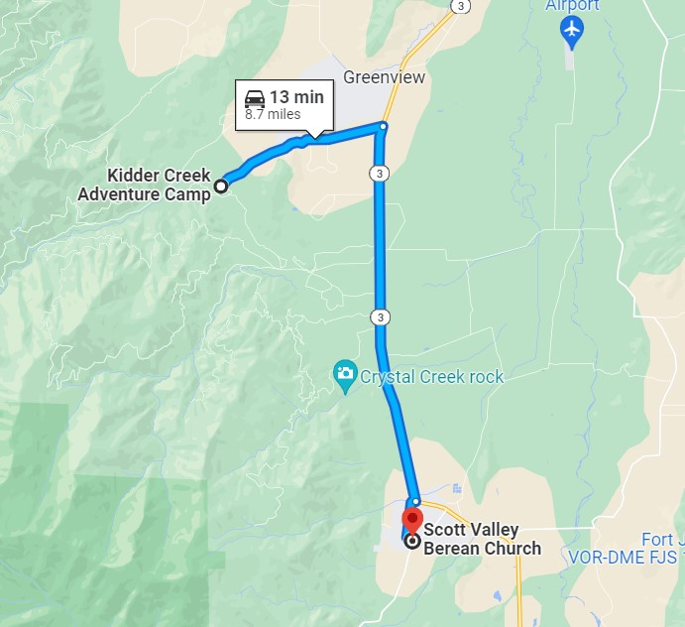
Current Evacuation
Drive Time and distance to Scott Valley Berean Church is 8.7 miles and a 13 minute drive – one way.

Slide 24
Current Evacuation
Current 2023 - Vehicle Capacity for use in Emergency
Vehicle | Capacity | Main Use
Rental Van | 10 | Wilderness
Rental Van | 10 | MTB
KC Yukon | 8 | Wilderness
Sequoia | 8 | MTB
Ford F250 - Black River Truck | 6 | River/Staff
Silverado | 6 | River/Staff
Ford F250 -Tim's Old Truck | 6 | River/Staff
Expedition | 8 | High Adventure
10 Pass Van - Blue | 10 | High Adventure
10 Pass Van - Oregon | 10 | High Adventure
Yukon XL(White) | 9 | High Adventure
KC Yukon XL(Silver) | 8 | High Adventure
10 Pass Van - Yreka | 10 | High Adventure
Sienna | 7 | Admin
Admin Vehicle | 5 | Admin
 | 121

Slide 25
Current Evacuation
Current Program Max Occupancy with staff
MTB | 16
Wilderness | 16
Ranch | 48
Timberline | 96
Support Staff/Other | 40
 | 216
Evacuation Timing | Cap | Timing | Notes
Evacuation 1 | 121 | 30 minute mark | Campers and Staff leave within 30 minutes of evacuation notice from the TRA
Evacuation 2 | 121 | 1 hour mark | Group 2 is Picked up and Depart for church
Evacuation 3 - if needed | 121 | 1.5 hour mark | Remaining Staff are evacuated
Evacuation 4 – if needed | 121 | 2 hour mark

Slide 26
Current Evacuation
Within 2 Hours
All campers and staff have been safely evacuated to the designated offsite location.

Slide 27
Evac Plan for Max. Occupancy
Evacuation Timing
Evacuation 1
KC Vehicles | 150 | 30 minute mark | Campers and Staff leave within 30 minutes of evacuation notice from the TRA
**Groups with Personal Transportation | 220
Staff/Volunteers/Guests | 50
Evacuation 2
KC Vehicles | 150 | 1 hour mark | Group 2 is Picked up and Depart for church
Evacuation 3
KC Vehicles | 150 | 1.5 hour mark | Remaining Staff are evacuated
3 Busses | 150
Evacuation 4 - If needed |  | 2 hour mark | All staff and campers evacuated safely
 |  |  | 30 minute flex to allow for unknowns
 | 870

Slide 28
Evacuation Plan for New Max. Occupancy
All Campers are safely evacuated within 2 hours.

Slide 29
Safety Zone
Our job is to: Get People Out.
In the Event it’s needed we have a maintained “Safety Zone” of ample size to hunker down in.

Slide 30
Safety Zone
Our goal is to never have to use the “Safety Zone”.
Our evacuation plan and fire behavior simulations have shown that under normal fire and most catastrophic fire conditions we will have plenty of time to evacuate our campers in a safe manner.
In the event of a catastrophic fire where we cannot get out Cal Fire has recommended that we stay put and “hunker down”, so they know where we are and can send resources our way.

Slide 31
Safety Zone
In the event that we do need to “hunker down” in the safety zone we have ample space using the “**Safety Zone Guideline of:
SSD = 8 * Slope Wind Factor * Height of the surrounding vegetation
Using 80’ for average vegetation height with a slope wind factor of 1 we need 640’ of safety zone.
With slope wind factor of 2 we need 1,280’ which with our safety zone and surrounding ***shaded fuel break area for our safety zone is ample.
**See Fuels Reduction and Safety Zone map
**Information gathered from www.firelab.org and www.firescience.gov Article info: International Journal of Wildland Fire Butler, BW (2014) Wildland firefighter safety zones: a review of past science and summary of future needs.
***Article “Creating a Safety Zone for use in a wildfire emergency” by bkvc; May 20, 2017; Preparing for fire. See comment about increasing safety zone by thinning around your safety zone.

Slide 33
Benefits to Community
Secondary Access Road available to neighbors on Patterson Creek Road and Valley Pines Area if needed in an emergency.
Water Source for firefighting in the new and existing ponds.
Good and pro-active forest management through regular maintenance and implementation of CFIP program on Kidder Creek Camp property which is a benefit to our neighbors.

Slide 34
Conclusion
When taking into account:
Simulations of fire behavior (including worst case scenarios)
Cal Fire suppression (which was not factored in sims)
Fuel break areas surrounding camp and ongoing forest management
Evacuation plan and
Safety zone space (if needed in a worst case scenario)
The Kidder Creek Wildland Fire Emergency Plan exceeds the requirements of the PRC 4290, Cal Fire has reviewed and provided feedback and agree that we have an adequate emergency plan.

